Slide 1

Intro to Web Design Using Bootstrap
REACH High - Spring 2016

Slide 2
Lesson 1: Your First Web Page

Slide 3
Web Page Design Steps
Define the Purpose/Goal
Sketch a design
Write it
Test it

Slide 4
Define the Purpose/Goal
During this class, we’ll be making a web site for a fictitious company named “Case Point” that makes phone cases.
The web site should provide information about the company, list the products, and provide a way to contact the company.

Slide 5
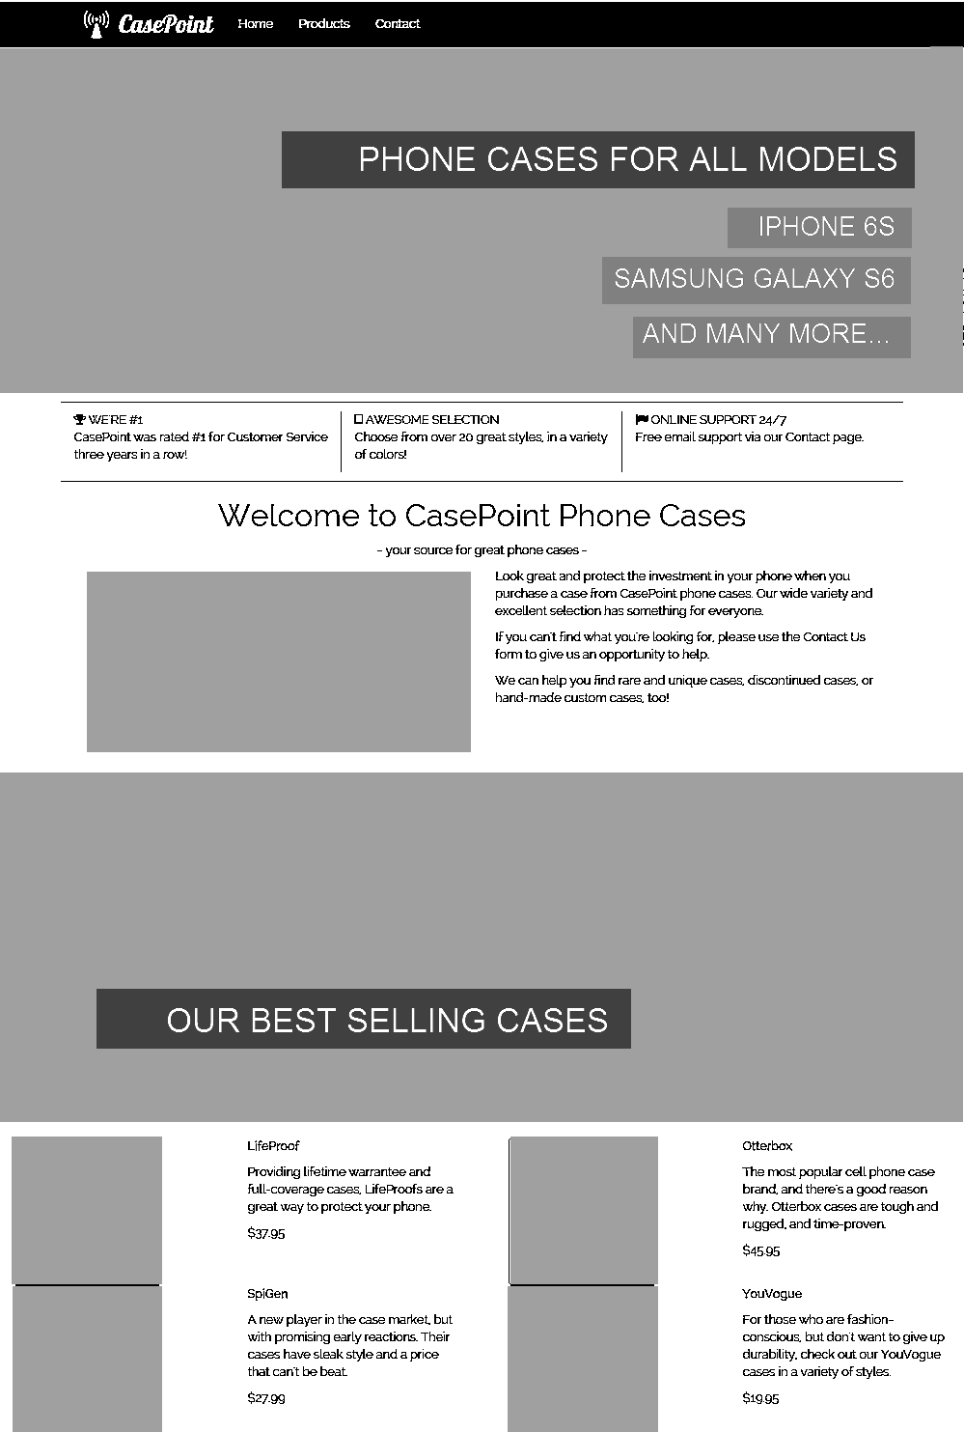
Sketch a design – Home Page
The grey boxes represent pictures or clip art that we’ll add.

Slide 6
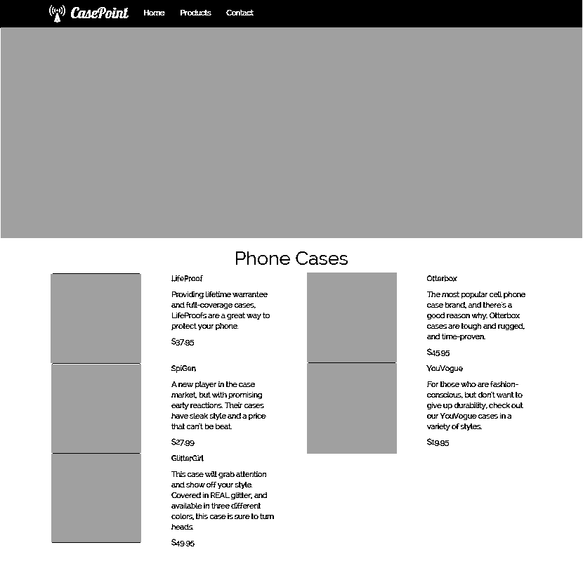
Sketch a design – Products

Slide 7
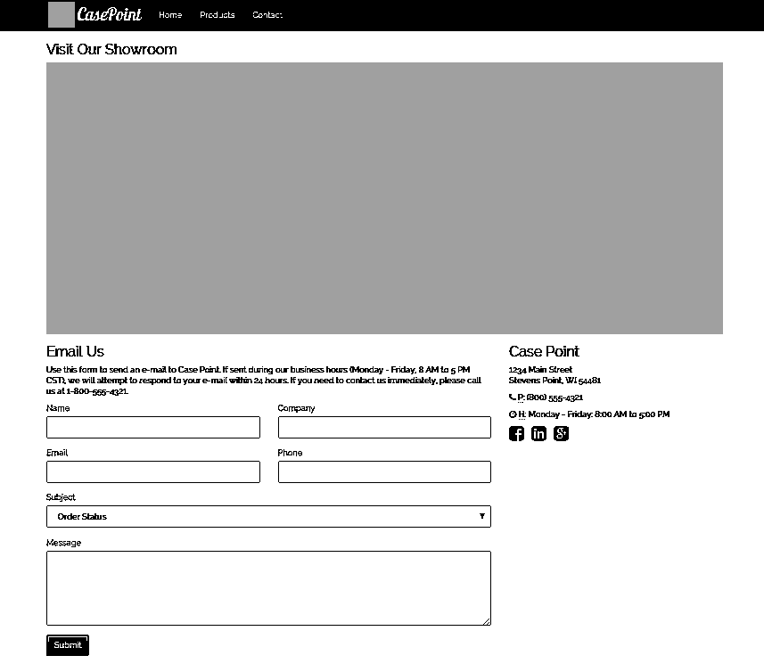
Sketch a Design – Contact

Slide 8
Write It
I’ll be using software called Brackets – a free app available for PC and Mac
I’ll be using Chrome browser primarily
I’ll use Pinta for image editing
You should have downloaded and installed these ahead of time

Slide 9
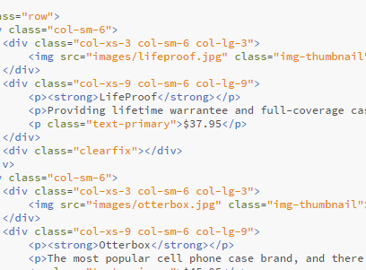
HTML
Hyper Text Markup Language
Stuff you add to a document to make it display in a web browser
Made up of tags: <div> <img>

Slide 10
Tags
Tags always surrounded by < and >
Different tags designate different things:
<p> designates a paragraph
<title> designates the web page title
<h1> designates a level-1 header

Slide 11
Opening and Closing Tags
Most tags require an “opening” tag: <title> and an “closing” tag: </title>
The content goes between them: <title>My Web Page Title</title>

Slide 12
Elements
The Opening and Closing tags, and everything in between them, is considered an Element.
P element: <p>My paragraph of text.</p>
Button element: <button>Click me!</button>

Slide 13
Attributes
Attributes go inside a tag to further define it: <div class="text-center"> <img src="images/logo.png">
Attributes are always put on opening tags; never on closing tags

Slide 14
Summary of HTML pieces
Opening Tag
Closing Tag
<div class="text-center">Hello World!</div>
Attribute
Element Contents
Element

Slide 15
Basic Web Page Anatomy
<!DOCTYPE html>
<html>
<head>
</head>
<body>
</body>
</html>
Special tag - specifies HTML version
Specifies this is HTML content
Header content
Body content

Slide 16
Indentation
<html>
<head>
<title>My title</title>
</head>
<body>
Body Content
</body>
</html>
Indentation is not necessary, but makes HTML more readable
For this class, please use indentation

Slide 17
Brackets Demo

Slide 18
Exercise 1

